Slide 1

Kyäni Opportunity Presentation

Slide 2

Launched in 2007
Founders with incredible experience and vision
Unparalleled financial backing
Operating in over 40 countries

Slide 3
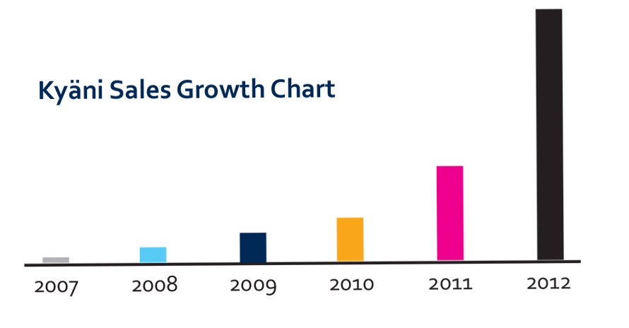

Slide 4


Wellness Industry
• The Health and Wellness Industry generates $500 Billion / year
• The Direct Sales Industry generates $120 Billion / year
• Industry revered by Robert Kiyosaki, Donald Trump and Warren Buffet
• Network marketing creates millionaires

Slide 5
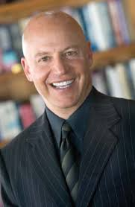
“The Health and Wellness Industry will be the next major force in business on the planet, reaching $1 TRILLION within the next 3 to 5 years!”
­Paul Zane Pilzer

Slide 6
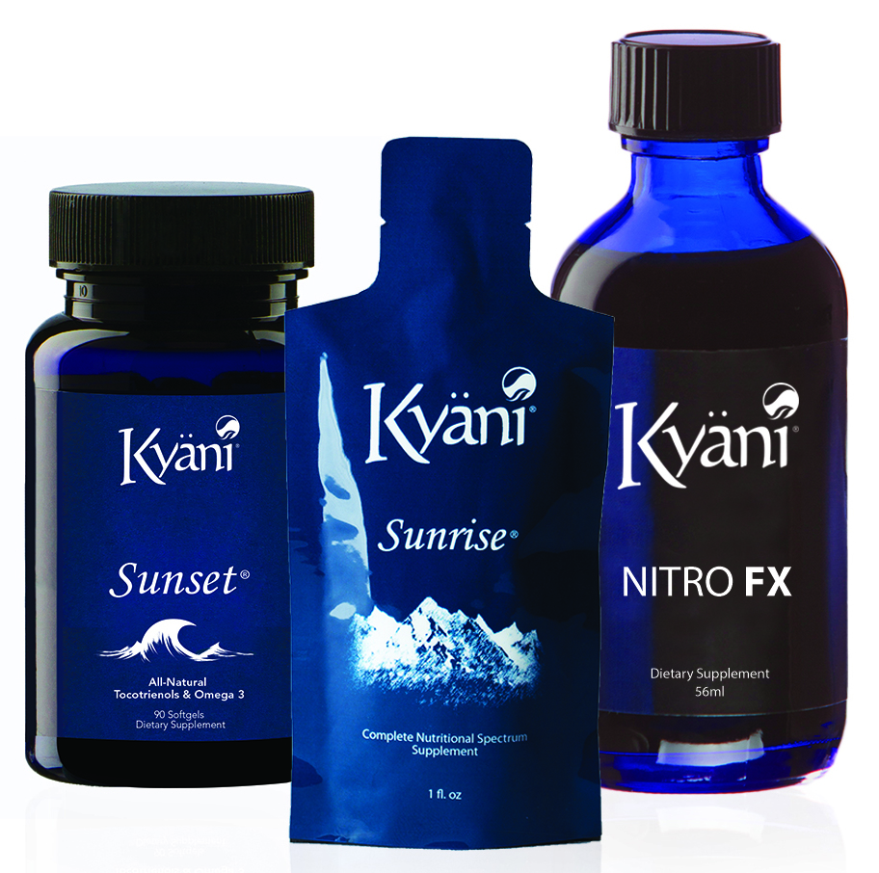
Kyani Health Triangle
Food Based – Natural Products
Kyäni Sunrise: A powerful nutraceutical featuring the Wild Alaskan Blueberry and 19 Superfruits and Vegetables
Kyani Sunset: A perfect combination of tocotrienols (the most impactful form of vitamin E) and omega­3s from Wild Alaskan Sockeye Salmon. Powerful source of Vitamin A & D
Kyäni NitroFX: A proprietary blend of Noni concentrate that has been proven to increase your body’s production of Nitric Oxide (NO)

Slide 7
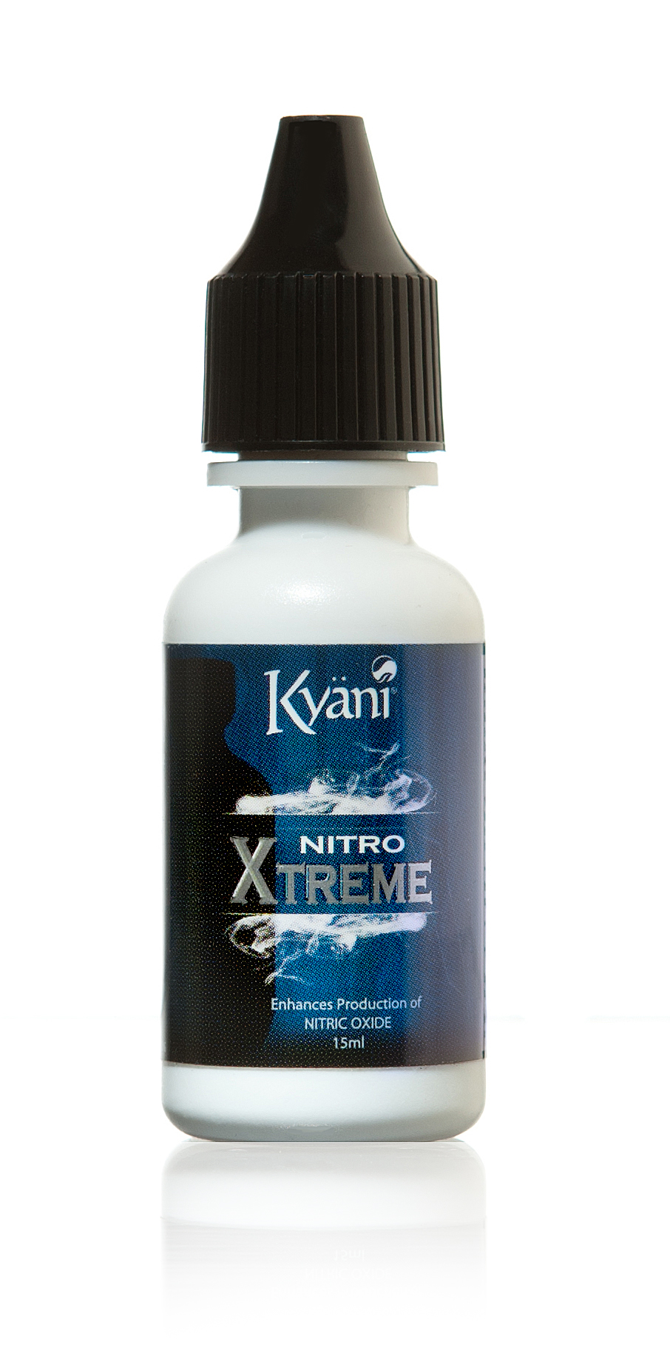
Kyani Nitro Xtreme
Nitric Oxide is known as the “Molecule of Life”
Backed by Nobel Prize Winning Research
Enhances the body’s production of Nitric Oxide
Over 120,000 studies and research papers support the use of Nitric Oxide

Slide 8

Customer Program
Tri - Pack for Distributor $129.00/mth
Tri - Pack for Customer $139.00/mth
LESS THAN $4.50/day

Slide 9

Personal Customers
20% Residual Commission of Autoship Customers
30 Day Money Back Guarantee
No Contracts on Autoship

Slide 10
5 x 5 x 5 System
5
25
125
= 155 distributors
Duplicate it & you’ve reached Sapphire

Slide 11
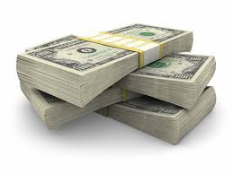
Average Monthly Income
Jade $255
Pearl $756
Sapphire $2,115
Ruby $4,611
Emerald $9,010
Diamond $15,373
Blue Diamond $25,958
Green Diamond $41,829
Purple Diamond $75,718
Red Diamond $95,759
Double Red Diamond
$205,323!

Slide 12
Residual Income
x x =
# of # of Average Monthly Distributors Customers Payout Residual
100
5
10%
$3,750

Slide 13
5 x 5 x 5 System
5
25
125
625
3,125
15,625
78,125
97,530 Distributors In Your Team

Slide 14
Residual Income
x x =
# of # of Average Monthly Distributors Customers Payout Residual
1000
5
10%
$30,000

Slide 15
Generation Check Match
15%
$1,150
____ x ______ x _____ = _______
# of Downline % Match Monthly Distributors Paycheck Residual
10
$1,000

Slide 16
Generation Check Match
15%
$11,150
___ x ________ x ____ = _______
# of Downline % Match Monthly Distributors Paycheck Residual
10
$10,000

Slide 17
Rank Bonus Program
Emerald $5,000 Bonus
Blue Diamond $25,000 Bonus
Purple Diamond $100,000 Bonus
Double Red Diamond $500,000 Bonus
Double Black Diamond $1,000,000 Bonus

Slide 18

Kyäni Car Program
Sapphire $500/month
Diamond $1,200/month
Green Diamond $2,500/month
Red Diamond $5,000/month
Black Diamond $10,000/month

Slide 19

Reward Trips
GVOY Cruise to the Caribbean
Kyäni Presidential Trip to Australia

Slide 20
Starter Kit
$499
1- Distributor Kit
1- Sunrise 30oz. Bottle
1- Sunrise 30 Pack
1- Sunset 90ct
1- Nitro FX 56ml
1- Nitro FX 8 Pack
1- Nitro Xtreme 8 Pack
5- 7 Day Trial Packs
1- 25 Pack - Sunrise, Sunset and Nitro FX Brochures
1 Year Free Webtools
$999
1- Distributor Kit
2- Sunrise 30oz. Bottle
2- Sunrise 30 1oz. Packets
2- Sunset 90ct
2- Nitro FX 56ml
2- Nitro FX 8 Pack
2-Nitro Xtreme 56ml.
2-Nitro Xtreme 8 Pk
15- 7 Day Trial Pks
1- 25 Pack of Sunrise, Sunset, Nitro FX, & Health Triangle Brochures
1 Year Free Webtools

Slide 21
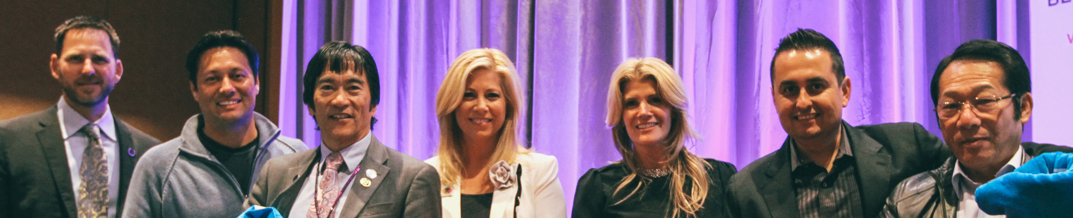
Support & Training
Weekly Conference Calls
Saturday Trainings
John C. Maxwell Event March 15th in L.A.
National Event Sept 5-6 in Las Vegas

Slide 22
Tools
Kyani Social in your Back Office
www.kyani.net
www.greatestversionofyou.com
www.kyaniscience.com

