Slide 1
THE KYÄNI OPPORTUNITY
Nov. 2015

Slide 2
INSERT JOSH TYLER VIDEO HERE https://vimeo.com/126060515

Slide 3
THE COMPANY - Launched in 2007 - Founders with experience and vision - Unparalleled financial backing - Operating in over 40 countries

Slide 4
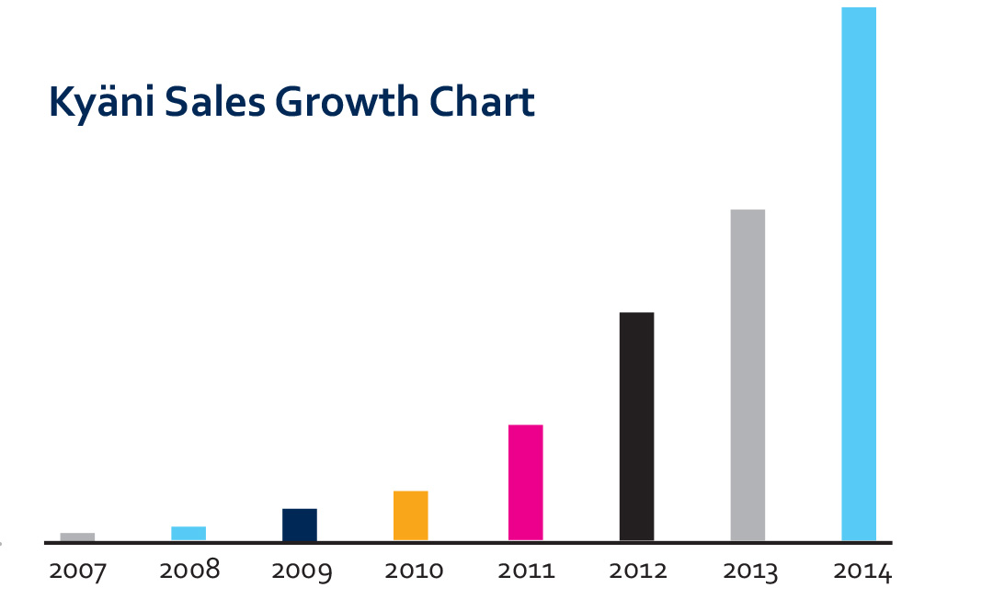

Slide 5
WELLNESS INDUSTRY
- The Health and Wellness Industry generates $500 Billion / year
- The Direct Sales Industry generates $120 Billion / year
- Industry revered by Robert Kiyosaki, Donald Trump and Warren Buffet
- Network marketing creates millionaires

Slide 6
“The Health and Wellness Industry will be the next major force in business on the planet, reaching $1 TRILLION within the next 3 to 5 years!”
­Paul Zane Pilzer

Slide 7
INSERT PRODUCT VIDEO HERE https://vimeo.com/136361362

Slide 8
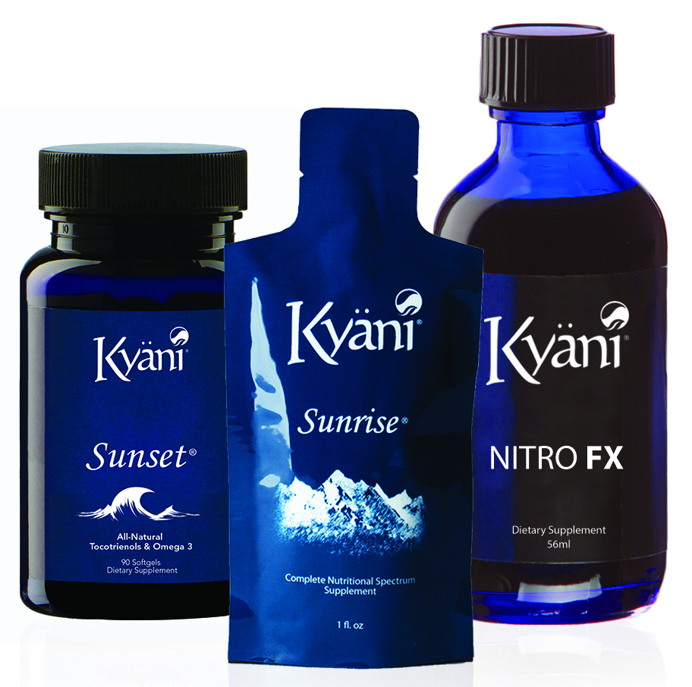
KYÄNI HEALTH TRIANGLE
Food Based, Natural Products
KYÄNI SUNRISE A powerful nutraceutical featuring Wild Alaskan Blueberries and twenty-two additional Superfoods
KYÄNI SUNSET A perfect combination of tocotrienols (the most impactful form of vitamin E), Omega­3, Vitamin D, and Beta Carotene
KYÄNI NITROFX A proprietary blend of Noni concentrate that has been proven to increase your body’s production of Nitric Oxide (NO)

Slide 9
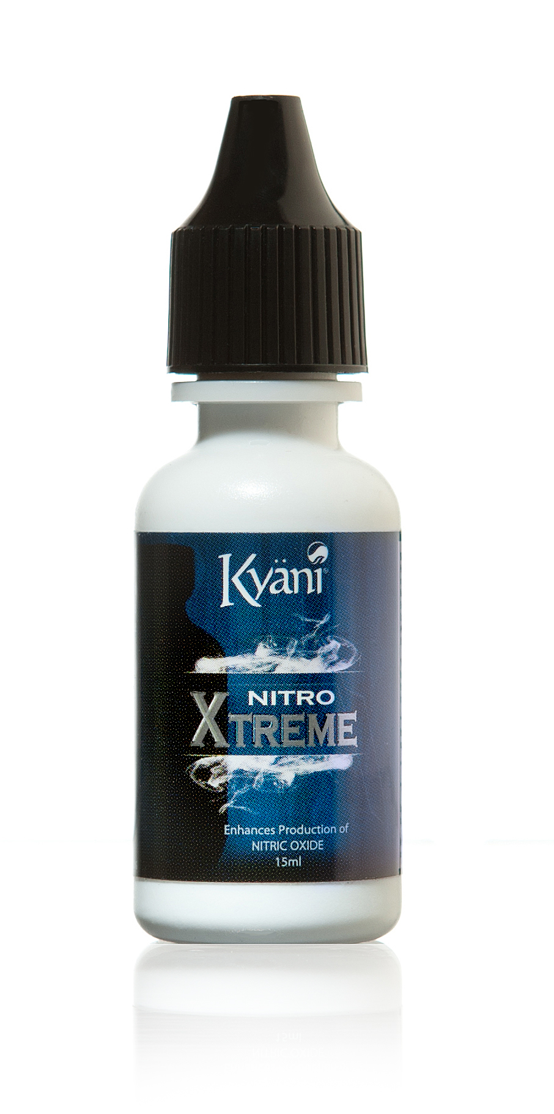
KYANI NITRO XTREME & POWDER
Nitric Oxide is known as the “Molecule of Life”
Backed by Nobel Prize Winning Research
Enhances the body’s production of Nitric Oxide
Over 120,000 studies and research papers support the use of Nitric Oxide

Slide 10
CUSTOMER PROGRAM
Tri - Pack for Distributor $129.00/month
Tri - Pack for Customer $139.00/month
LESS THAN $4.50/day

Slide 11
PERSONAL CUSTOMERS
20% Residual Commission of Autoship Customers
30 Day Money Back Guarantee
No Contracts on Autoship

Slide 12
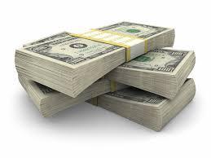
AVERAGE MONTHLY
INCOMES
Jade $298
Pearl $659
Sapphire $1,561
Ruby $3,569
Emerald $7,416
Diamond $13,985
Blue Diamond $25,757
Green Diamond $46,949
Purple Diamond $56,473
Red Diamond $95,759
Double Red Diamond
$205,323!
The figures contained herein are for educational purposes only, and are not to be relied on, interpreted or construed as a warranty or guaranty by Kyäni that all Kyäni distributors will achieve the results contained herein. Individual results will vary by Distributor. Your earnings based on your participation in the Kyäni Global Compensation Plan will be based on many factors, including your individual skills and abilities, hours worked and market conditions.

Slide 13
5 X 5 SYSTEM
5
25
125
= 155 distributors

Slide 14
RESIDUAL INCOME
x x =
# of # of Average Monthly Distributors Customers Payout Residual
100
5
10%
$3,750

Slide 15
5 X 5 SYSTEM
5
25
125
625
3,125
15,625
78,125
97,530 Distributors In Your Team!

Slide 16
RESIDUAL INCOME
x x =
# of # of Average Monthly Distributors Customers Payout Residual
1000
5
10%
$37,500

Slide 17
GENERATION CHECK MATCH
15%
$1,500
____ x ______ x _____ = _______
# of Downline % Match Monthly Distributors Paycheck Residual
10
$1,000

Slide 18
GENERATION CHECK MATCH
15%
$15,000
___ x _______ x ____ = _______
# of Downline % Match Monthly Distributors Paycheck Residual
10
$10,000

Slide 19
RANK BONUS PROGRAM
Emerald $5,000 Bonus
Blue Diamond $25,000 Bonus
Purple Diamond $100,000 Bonus
Double Red Diamond $500,000 Bonus
Double Black Diamond $1,000,000 Bonus

Slide 20
Kyäni Car Program
Sapphire $1,000 down + $500/month
Diamond $4,000 down + 1,200/month
Green Diamond $2,500/month
Red Diamond $5,000/month
Black Diamond $10,000/month

Slide 21
REWARD TRIPS
Kyäni Presidential Trip

Slide 22
STARTER KITS
$569
1- Kyäni Sunrise
1- Kyäni Sunrise (Packets)
1- Kyäni Sunset
1- Kyäni Nitro FX
1- Kyäni Nitro FX 15 ml 8 Pack
1-Kyäni Nitro Xtreme
1-Kyäni Nitro Xtreme 15 ml 8 Pk
2- 7 Day Trial Pack
1- New Distributor Folder
6 months Webtools
$999
2- Kyäni Sunrise
2- Kyäni Sunrise (Packets)
2- Kyäni Sunset
2- Kyäni Nitro FX
2- Kyäni Nitro FX 15 ml 8 Pack
2-Kyäni Nitro Xtreme
2-Kyäni Nitro Xtreme 15 ml 8 Pk
10- 7 Day Trial Pack
1- New Distributor Folder
1 Year Webtools

Slide 23
SUPPORT & TRAINING
Weekly Conference Calls
Saturday Trainings
National & International Events

Slide 24
TOOLS
Kyäni Back Office
www.kyani.net
www.greatestversionofyou.com
www.kyaniscience.com

Slide 25
THE KYÄNI OPPORTUNITY

